Slide 1
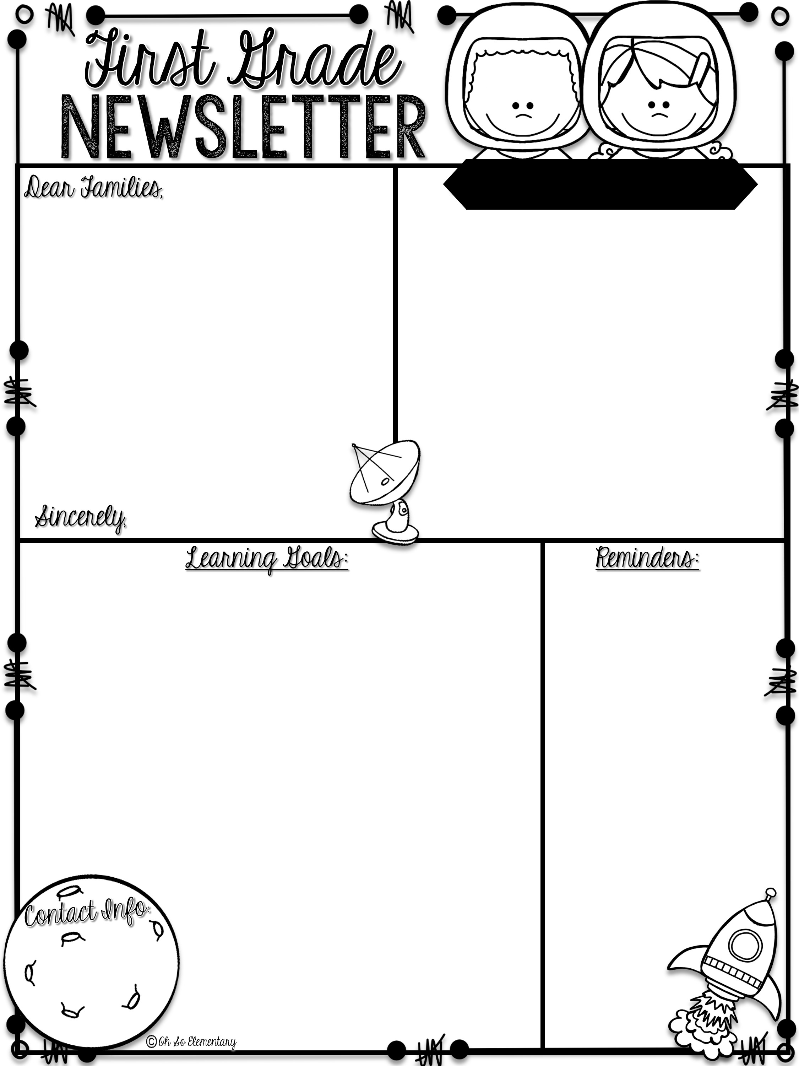
Week of August 21-25
Please remember to send a water bottle and snack daily.
Reading homework is on the back of this newsletter and math is in the folder/sleeve behind it.
Upcoming dates and events
Progress Reports- 9/7
School Pictures-9/7
Student of the Week
First Grade Teachers
Spelling
Theme: Friendship: Friends to the Rescue | Phonics/Reading: Short i Language: Plural nouns s as (z)
Math: Recognize number partners of 10 +2 Fact test | Writing: Answer questions about a story in complete sentences.
 | Homework: Due Friday Sight Words: Review: and, see, the, to New: but, her, not, of
fin
quiz
rib
lid
Yak
sap

Slide 2
ELA Homework Name_____________________
Sid the Pig
Sid the Pig Sid is a big pig. Sid the pig has on a wig and a bib. Sid gets in a pit. Sid did a jig and hit his rib in the pit. Now Sid has to sit in the pit. Sid is a big pig with a wig and a bib.
Circle all the short i words with a blue crayon.
Underline the words that are nouns.
Who are the characters in the story? ______________
How did Sid hit his rib? __________________
List the nouns in the story. __________ _________ ________ __________ __________

